Slide 1
Finding Anagrams v1.0: An ETL python, pandas, NumPy, and SQLite tutorial
Mike Babb
babbm@uw.edu
February 20, 2021

Slide 2
Outline
Motivating questions
Definitions
Data
Methods
Results
Code Definitions

Slide 3
Motivating Questions and Goals
Given a list of English words, what are the groups of anagrams? (EXTRACT)
How do we discover the groups of anagrams? (TRANSFORM)
How do we store the groups of anagrams for quick and easy retrieval? (LOAD)
We will use python and the pandas and NumPy libraries and SQLite Database platform to build an EXTRACT – TRANSFORM – LOAD (ETL) pipeline.

Slide 4
Definition
An anagram of a focal word is created by rearranging some or all of the letters to form a new and valid word.
‘time’ can be rearranged to form the words ‘item’, ‘emit’, and ‘mite’.
Letters in the word ‘terminator’ can be arranged to spell ‘time’, ‘item’, ‘emit’, ‘mite’ as well as many more.
‘time’, ‘item’, ‘emit’, and ‘mite’ are exact anagrams of each other.
We can describe the word ‘terminator’ as a from/parent word of ‘time’-’item’-’emit’-’mite’ to/child words.
Likewise, ‘tie’ is a to/child anagram of ‘time’-’item’-’emit’-’mite’ and a to/child anagram of ‘terminator’
And ‘it’ is a to/child anagram of ‘tie’

Slide 5
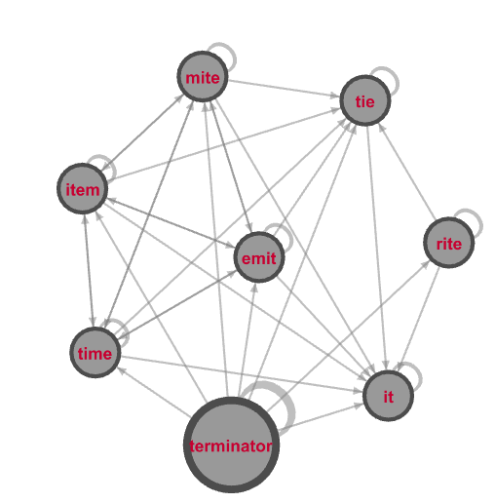
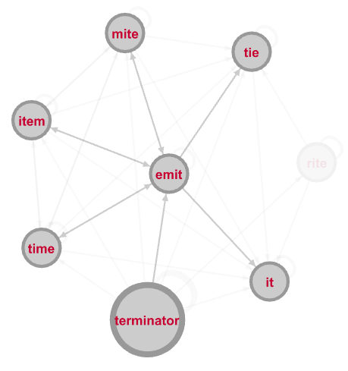
These from/to relationships can be stored as a graph…
Directed relationships with the word ‘emit’
Made using Gephi: https://Gephi.org/
Directed relationships with demonstration words

Slide 6
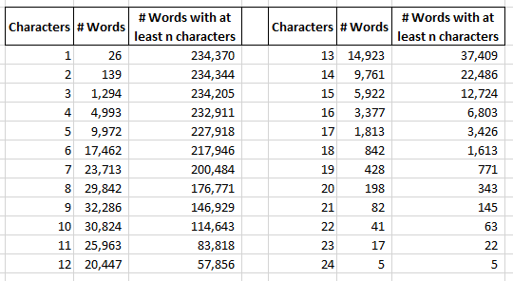
Data: ~234K English Words

Slide 7
Methods:
We know that the word ‘time’ can be formed from ‘terminator’. How do we formalize this from/to relationship?
We can’t use default string methods: i.e. str.find()
We could use python’s set() objects to compare membership, and we will to some extent, but that ignores letter frequency
We will capture the from/to relationship of each word using vectors and matrices

Slide 8
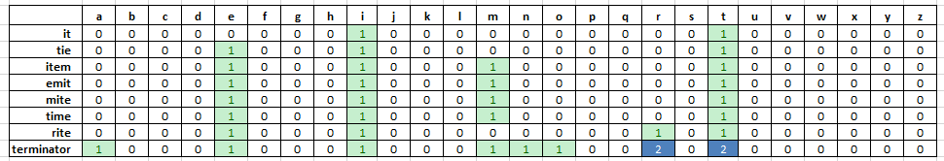
EXTRACT: Vector membership
Each word can be expressed as a vector that is 26 items long
Each position in the vector holds the count of letters in each position
Our example words can be expressed as a series of vectors and combined into a single matrix called ‘candidates’:

Slide 9
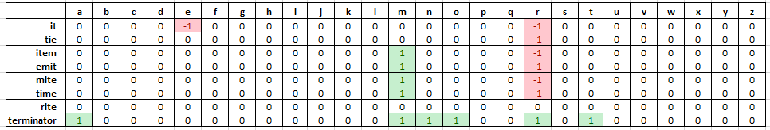
Matrix Subtraction
Subtracting the ‘rite’ row (the focal word) from the ‘candidates’ matrix produces a new matrix
Values < 0 indicate the count of letters in a position in the focal word vector is greater than the count of letters in the same position in the ‘candidates’ matrix
Values = 0 indicate the count of letters in the respective positions are the same
Values > 0 indicate the count of letters in the ‘candidates’ matrix have more letters than in the focal word vector

Slide 10
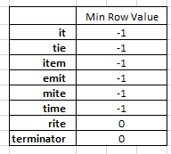
Row-wise operations
We need to examine all characters in each row for membership, not just each cell
Computing the minimum value of each row indicates relationships between each word:
Values >= 0 indicate that the focal word ‘rite’ is nested in the ‘candidates’ matrix
Values < 0 indicate that the focal word ‘rite’ is not nested in the ‘candidates’ matrix
For each focal word, this yields the from/parent words

Slide 11
Python objects and methods:
File i/o
Read, write, pickle
SQLite
Data storage and retrieval
Pandas Data frame
Aggregate, sort, vectorized operations
NumPy
1d and 2d arrays, row-wise and column-wise operations
Sets
intersection
Lists
comprehension
Dictionary
Creation, comprehension, and data structuring for fast lookups

Slide 12
SQLite SQL statements and techniques
Database creation, connections, and cursors
Select
Insert
Create table
Insert (into)
Drop table
Add index

Slide 13
TRANSFORM: Four Processing Techniques
Each processing technique performs the same general calculation: Subtract a focal row from a matrix of candidates, determine the minimum row values, and generate a list of from/to words
The four different processing techniques take advantage of the frequency distribution of letters and length of words to illustrate how a little pre-processing can mean an algorithm that takes ~106 minutes to complete versus an algorithm that takes ~6 minutes to complete
Note: The EXTRACT and TRANSFORM portion of this will take 6 to 106 minutes, depending on processing technique, the LOAD PORTION will always take ~11.

Slide 14
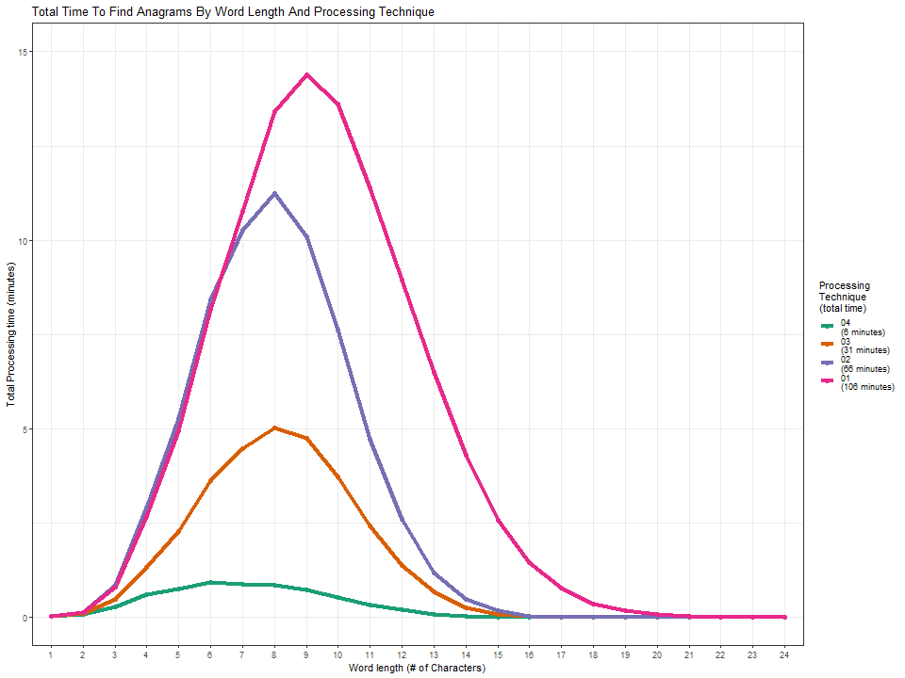

Slide 15
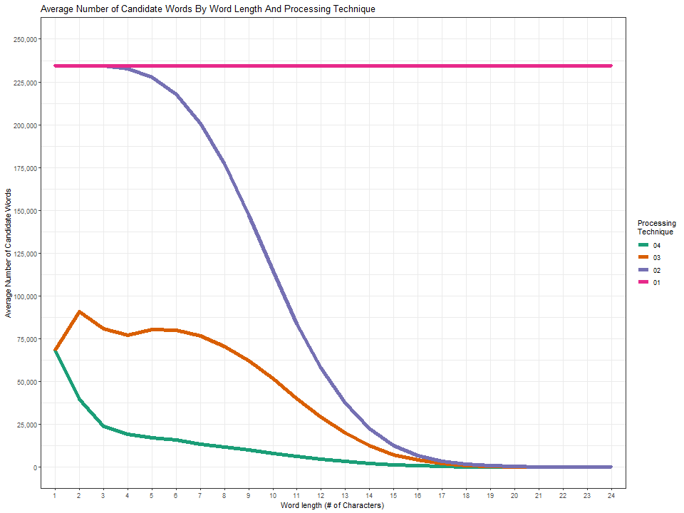

Slide 16
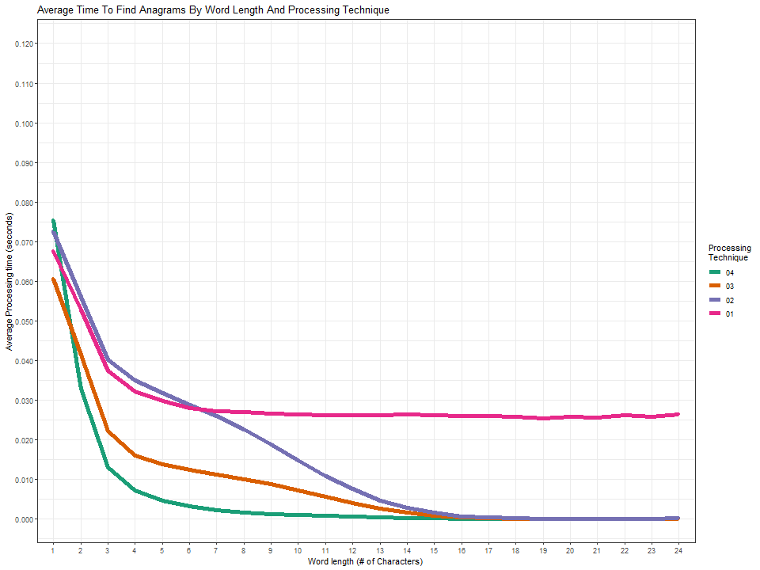

Slide 17
Process control flags
Four control flags in part_02_generate_and_store_anagrams.ipynb
Specify the processing option:
matrix_extraction_option = 1, 2, 3, or 4
Number of letters to use for processing option #4 (ignored otherwise):
n_common_letters = 1 through 24
Save the generated lists of anagrams to the SQLite DB:
write_data = True
Process only words beginning with a certain letter or a group of letters:
letter_subset_list = [‘t’, ‘w’]
Notes:
Move this slide to the end

Slide 18
Option 1: All-word matrix
Perform ~234K calculations on a ~234K row x 26 column matrix
Each row is compared against all other rows
Least amount of code, simplest to understand, ranked 4th in time to complete

Slide 19
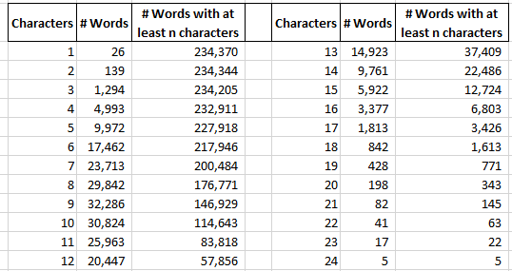
Option 2: sub-matrices split by word length
Create 24 sub-matrices, each consisting of words >= n characters
A word that is 14 characters long needs to search in a matrix that is 22K rows, 10% of the size of the full matrix
More code and more complex than option 1; ranked 3rd in time to complete.

Slide 20
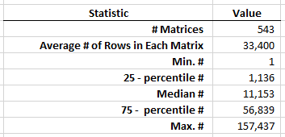
Option 3: sub-matrices by word-length and presence of focal letter
Determine the matrix rows featuring words that are >= n characters long: row groups A
Determine the matrix rows that contain a focal letter: row groups B
Compute the set intersection of row groups A and row groups B: row groups C
Row groups C are candidate rows for a focal word
More code and more complex than option 2; ranked 2nd in time to complete.

Slide 21
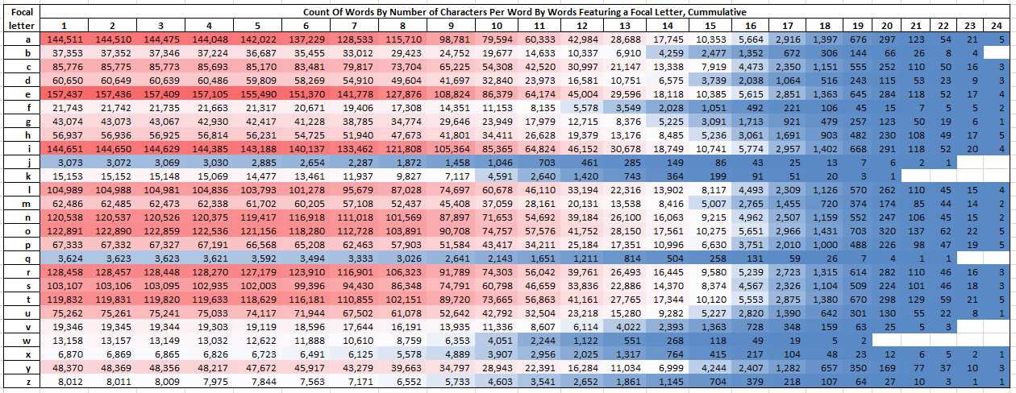

Slide 22
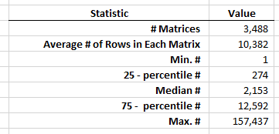
Option 4: sub-matrices by word-length and presence of two least common letters
Determine the rows featuring words that are >= n characters long: row groups A
Determine the two least common letters (lcl) in each word
Determine the rows that match each lcl group: row groups B
Compute the set intersection of row groups A and row groups B: row groups C
Row groups C are the candidate rows for a focal word
More code and more complex than option 3; ranked 1st in time to complete.
Notes:
Add the frequency of letters

Slide 23
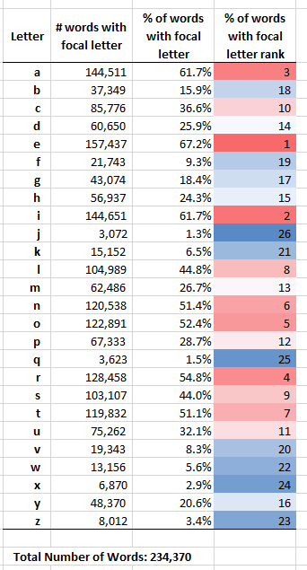

Slide 24
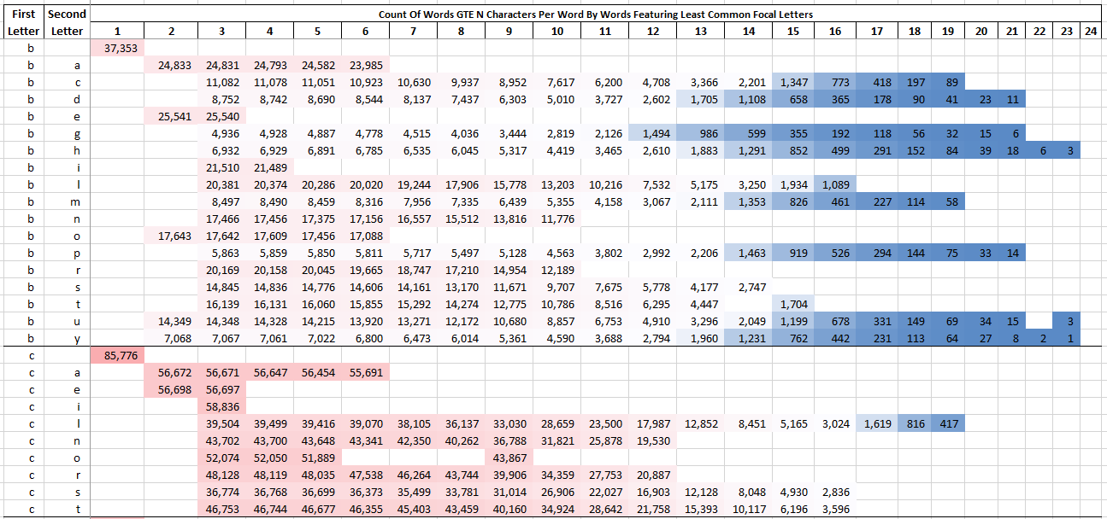
Focal word
Letter rankings
‘battery’: [18,3,7,7,1,4,16]. The two least common letters [b, y] in a GTE 7-letter word are found in 6,473 candidate words.
Notes:
Add a word example that is the least common example

Slide 25
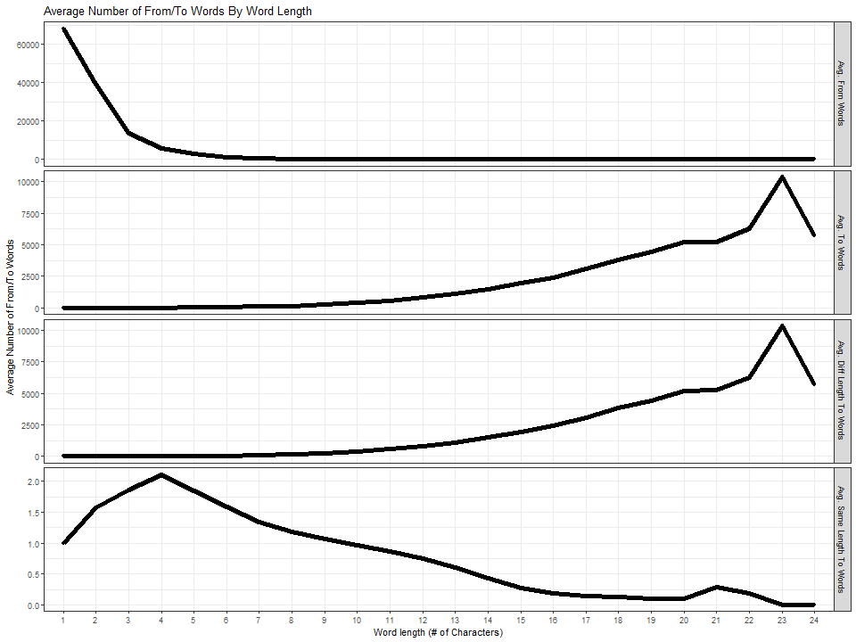

Slide 26
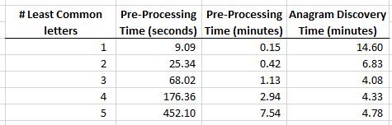
Why not add more least common letters?
Diminishing returns!
Pre-processing time increases quickly while anagram discovery time decreases modestly

Slide 27
Additional notes on processing
Counters are included to keep track of the number of from/to relationships and exact word matches
Processing time of each word is recorded to evaluate performance and generate summary statistics
Loops are used to help divide the operation by letter for testing
Each processing option writes to a different output table. For example, processing option ‘2’ writes to the ‘words_me_02’ table
All processing options will overwrite the ‘anagrams’ and ‘words’ tables
All processing options make use of numerical word IDs facilitating integer comparisons; actual words are referenced sparingly
Notes:
Move to end

Slide 28
LOAD: Storing data in SQLite
Data are written to SQLite (https://www.sqlite.org/index.html):
pandas.to_sql()
sqlite3.connection().cursor().executemany()
Database facilitates additional interaction:
Single access point for a variety of platforms (i.e. Python and R)
Indices
quick data access
It takes about 11 minutes to write the anagram pairs to the db.
Note: The EXTRACT and TRANSFORM portion of this will take 6 to 106 minutes, depending on processing technique, the LOAD portion will always take ~11 minutes.

Slide 29
Scripts involved
part_00_process_functions.py
part_01_structure_data.ipynb
part_02_generate_and_store_anagrams_v1.0.ipynb
part_03_query_anagram_database.ipynb
part_04_add_database_indices.ipynb
part_05_build_a_graph.ipynb
part_06_visualize_processing_time.R
simple_fractal.ipynb

Slide 30
Part 00: process functions
part_00_process_functions.py
Code reuse for parts 3, 4, and 5
Several functions are called in multiple scripts. Define the function once and import it.

Slide 31
Part 01: structure data
part_01_structure_data.ipynb
Import the list of words into a pandas data frame
Extract first letter of each word
Count letters in each word
Generate the character matrix: the count of letters in each word by letter position: the 234K row by 26 column matrix
Save objects
Script completes in about 5 minutes

Slide 32
Part 02: Generate Anagram Pairs
part_02_generate_and_store_anagrams_v1.0.ipynb
Set processing and data save options
Compute anagram pairs using desired processing technique
Save output to SQLite
Script execution takes anywhere from 6 minutes to 106 minutes, depending on processing technique

Slide 33
Part 03: Querying data
part_03_query_anagram_database.ipynb
Specify a focal word
Query a database table without the benefit of indices
Generate a list of from and to words using a series of SQL statements
Each operation will take ~90 seconds to complete, three minutes total

Slide 34
Part 04: Add indices
part_04_add_database_indices.ipynb
Add indices to the database tables using Python
Execute a series of SQL statements to add three indices to the database
Index the word_id in the words table
Index the from_word_id in the anagrams table
Index the to_word_id in the anagrams table
Completes in about 7 minutes

Slide 35
Part 03: Querying data (again)
part_03_query_anagram_database.ipynb
Query a database table with the benefit of indices
each operation takes ~0.01 seconds to complete, script takes less than a minute to complete

Slide 36
Part 05: Extracting data to build a graph
part_05_build_a_graph.ipynb
Query the SQLite database
Create a graph object using the NetworkX python library
https://networkx.org/
Save the graph object for import into Gephi
https://Gephi.org/

Slide 37
Part 06: Visualizing Timing
part_06_visualize_processing_time.R
Use R and the following libraries: data.table, ggplot2, magrittr, RSQLite, and stringi
Demonstrate how to connect to a SQLite db, query data, and plot data
Generate the previously seen plots

Slide 38
Finding Anagrams v2.0: TBD
Build upon v1.0 by using unique word groups instead of words
i.e. compare the (‘e’, ‘i’, ‘m’, ‘t’) word group against other word groups
The four words in word group (‘e’, ‘i’, ‘m’, ‘t’) are found in ~61K other words
The word group (‘e’, ‘i’, ‘m’, ‘t’) is found in ~15K other word groups
Reduce the initial search space from ~234K items to ~216K items
Less storage space required and quicker data access time

Slide 39
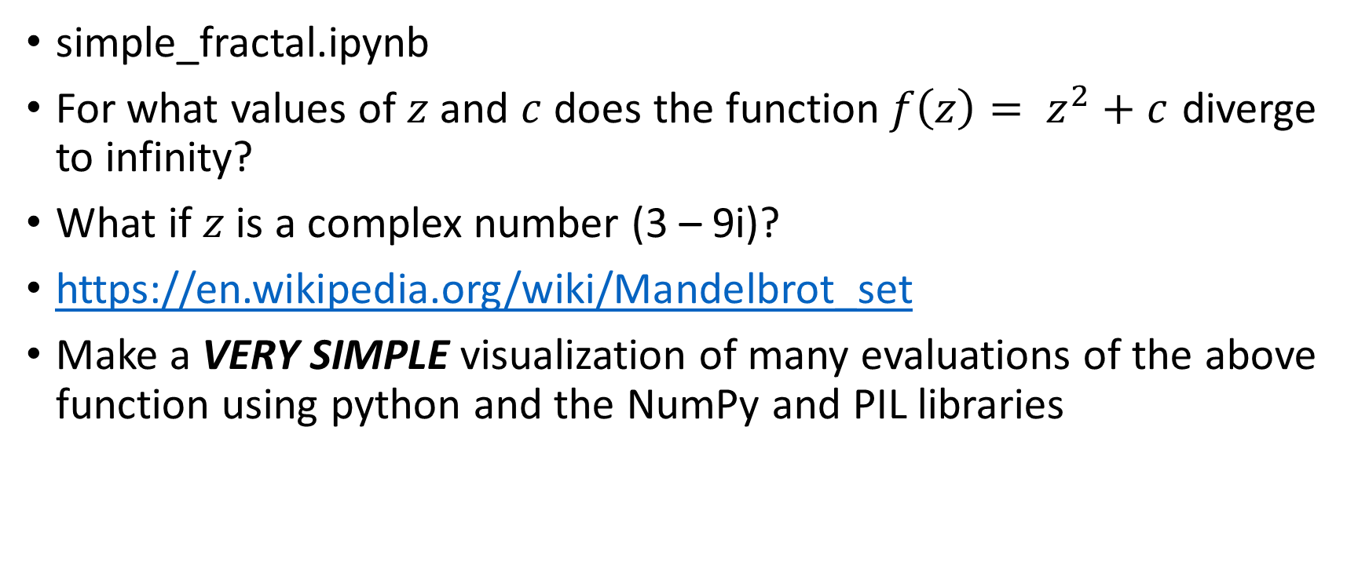
Bonus - visualize the Mandelbrot set
simple_fractal.ipynb
For what values of $z$ and $c$ does the function$f\left(z\right)= z^{2}+c$ diverge to infinity?
What if $z$ is a complex number (3 – 9i)?
https://en.wikipedia.org/wiki/Mandelbrot_set
Make a VERY SIMPLE visualization of many evaluations of the above function using python and the NumPy and PIL libraries

Slide 40


